Slide 1

Indexing for Life
FP7 – 261555
Guy Cochrane Bioinformatics, Leader WP 7
European Bioinformatics Inst., Cambridge
David Remsen Biodiversity Informatics, Leader WP 6
Global Biodiversity Information Facility, Copenhagen
Peter Schalk Biodiversity Informatics, Leader WP 4
ETI Bioinformatics, Amsterdam
Frank Bisby Taxonomy & Informatics, Coordinator
Biological Sciences, University of Reading

Slide 2

This new Proposal:
Indexing for Life (2010 – 2013)
is to establish a Virtual Research Community to
integrate the indexing of biological species
between the world’s major biodiversity programmes.
It will use the existing Catalogue of Life as a yardstick
with which to compare and unify what is known.
It will for the first time provide a summary of all
species known across these programmes.
It will create a global standard for taxonomic data
integration in electronic infrastructures world-wide.

Slide 3
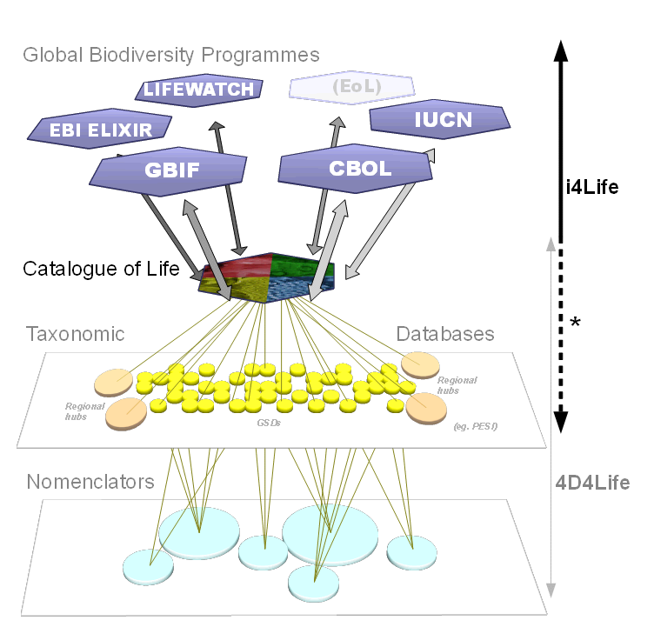

Slide 4
Q2 Standardisation Measures
Yes, this project is ultimately all about standardisation and data integration.
i) i4Life will add a new layer of taxonomic standardisation to the array of
global partners that are already deeply involved in standardisation within
their own communities. For example, synonymic indexing makes a
significant contribution to biodiversity data integration, both across the world,
and across these biodiversity disciplines.
ii) It goes without saying that CoL technical systems, as well as those of the
global partners, are committed users of existing community-wide data and
informatics standards. Sp2000 was even started by TDWG, the standards
body, in 1994.
iii) In this project will attempt to set new standards for comparative workflows
between different large-scale taxonomies.

